Slide 1
Final Presentation
Will Borom
Julio Perez
Carl Martinez

Slide 2
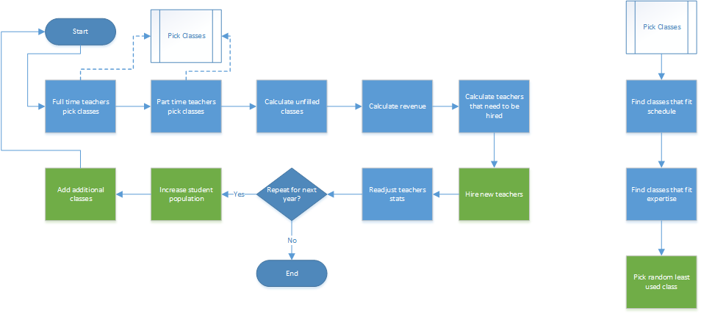

Slide 3
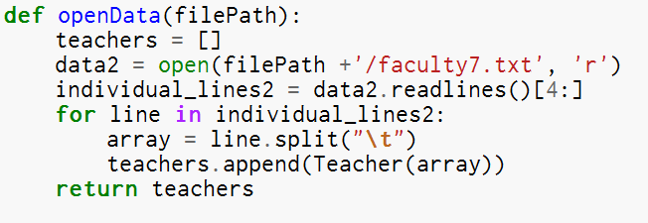
Reading in Data

Slide 4
Class Structure
Teacher.py
CourseCruncher.py
Expertise.py
AbstractCourse.py
Courses.py
Time.py

Slide 5
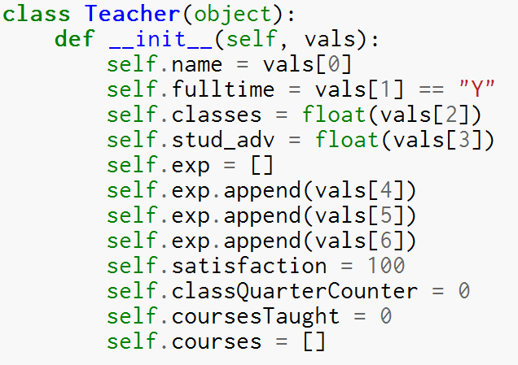
Teacher.py
Holds each teachers information
addClass(self, course) method allows each teacher to keep track of courses they are teaching

Slide 6
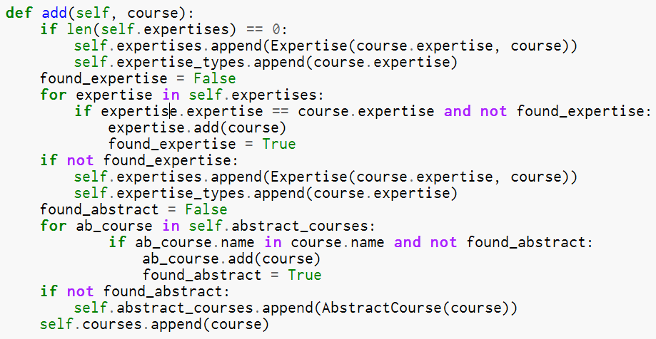
CourseCruncher.py
Contains each Expertise object
Adds in each course and places them in the correct containers
Maintains all courses

Slide 7
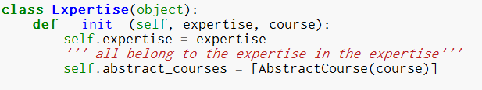
Expertise.py
Contains all AbstractCourse objects
Separated by a given expertise

Slide 8
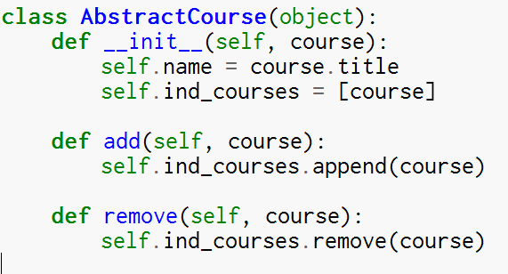
AbstractCourse.py
Holds all courses separated by abstract course type
For example all 343 classes are grouped together

Slide 9
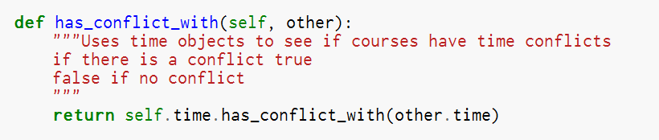
Course.py
Contains specific information about each class
Contains a Time object
Allows for Time object comparisons to be performed directly with other Course objects

Slide 10
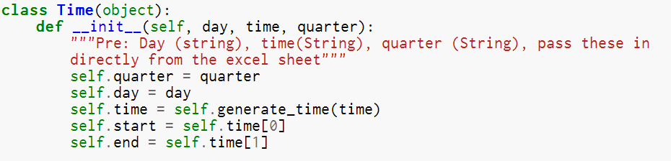
Time.py
Abstracts the course time by entering a string
Can then be used with other Time objects to facilitate comparison
Stores all relevant data for a courses time

